Slide 1



Smart Agriculture System Using IoT
Submitted By:ASHISH KUMAR

Slide 2
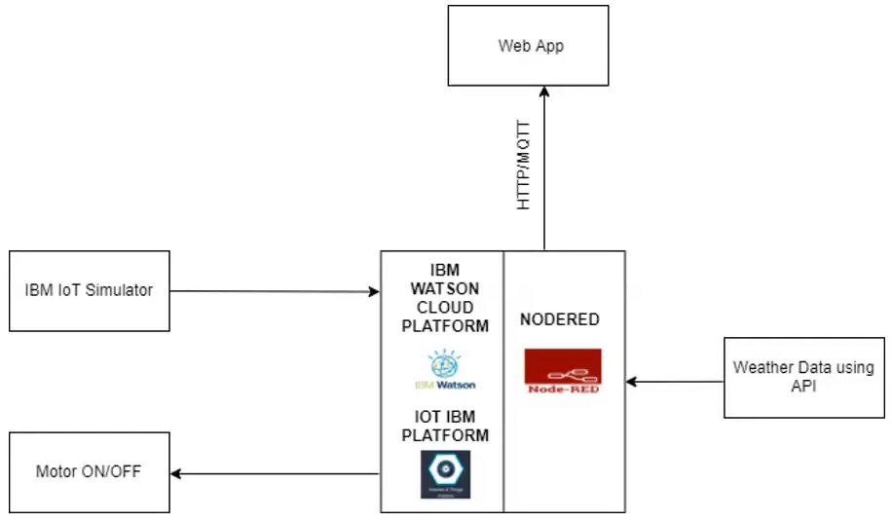
Block Diagram

Slide 3

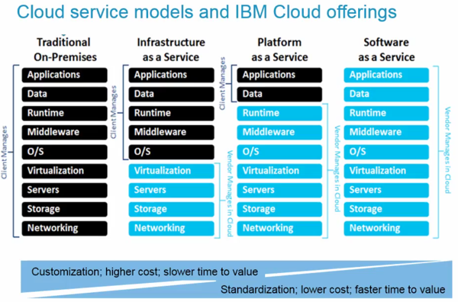
IBM Cloud

Slide 4
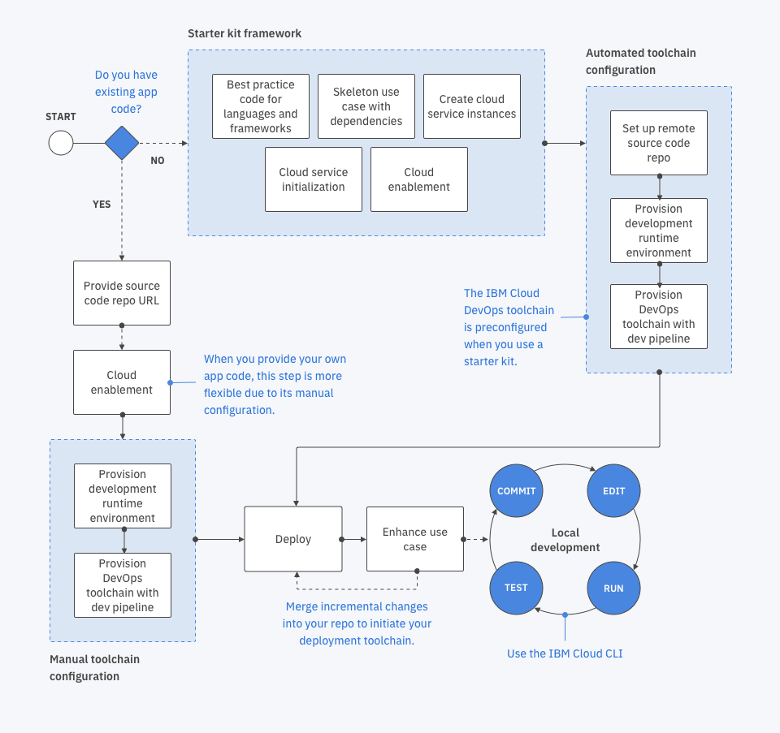
IBM BLUEMIX

Slide 5
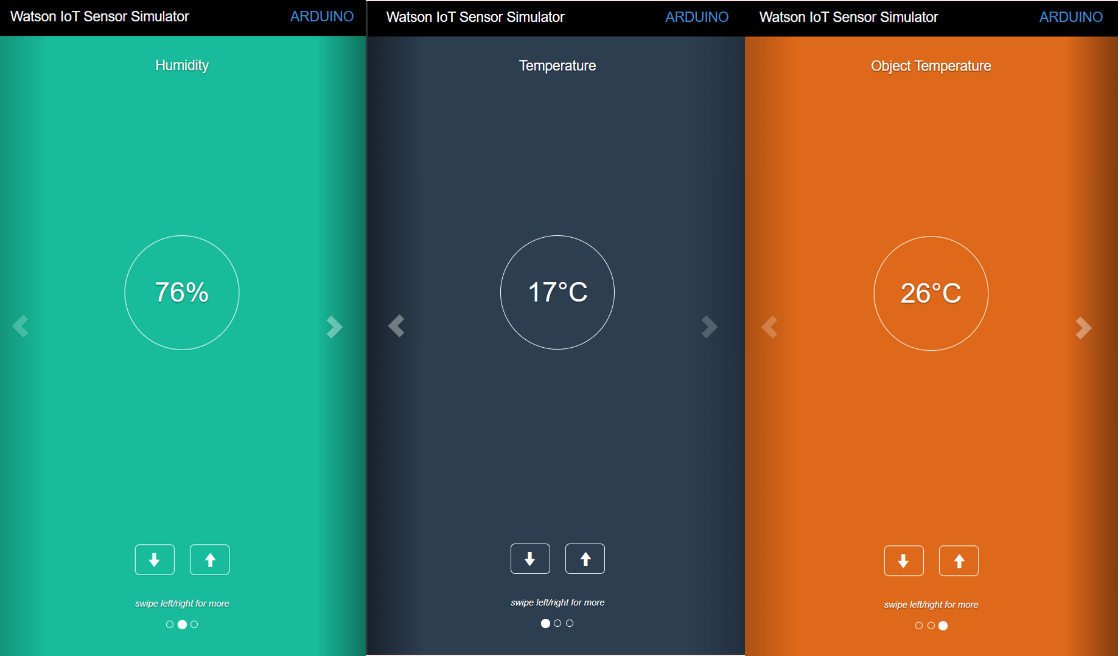
IBM IoT Simulator

Slide 6
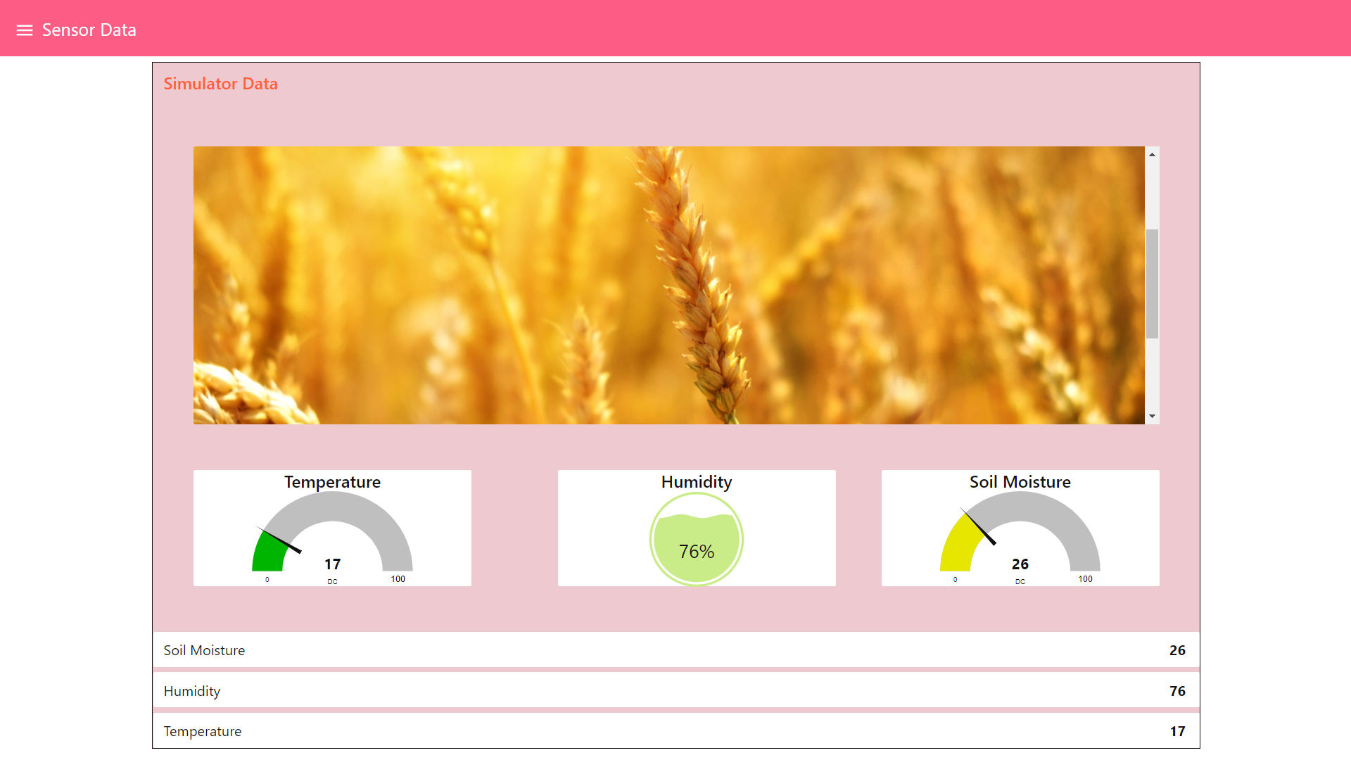
Node-red UI

Slide 7
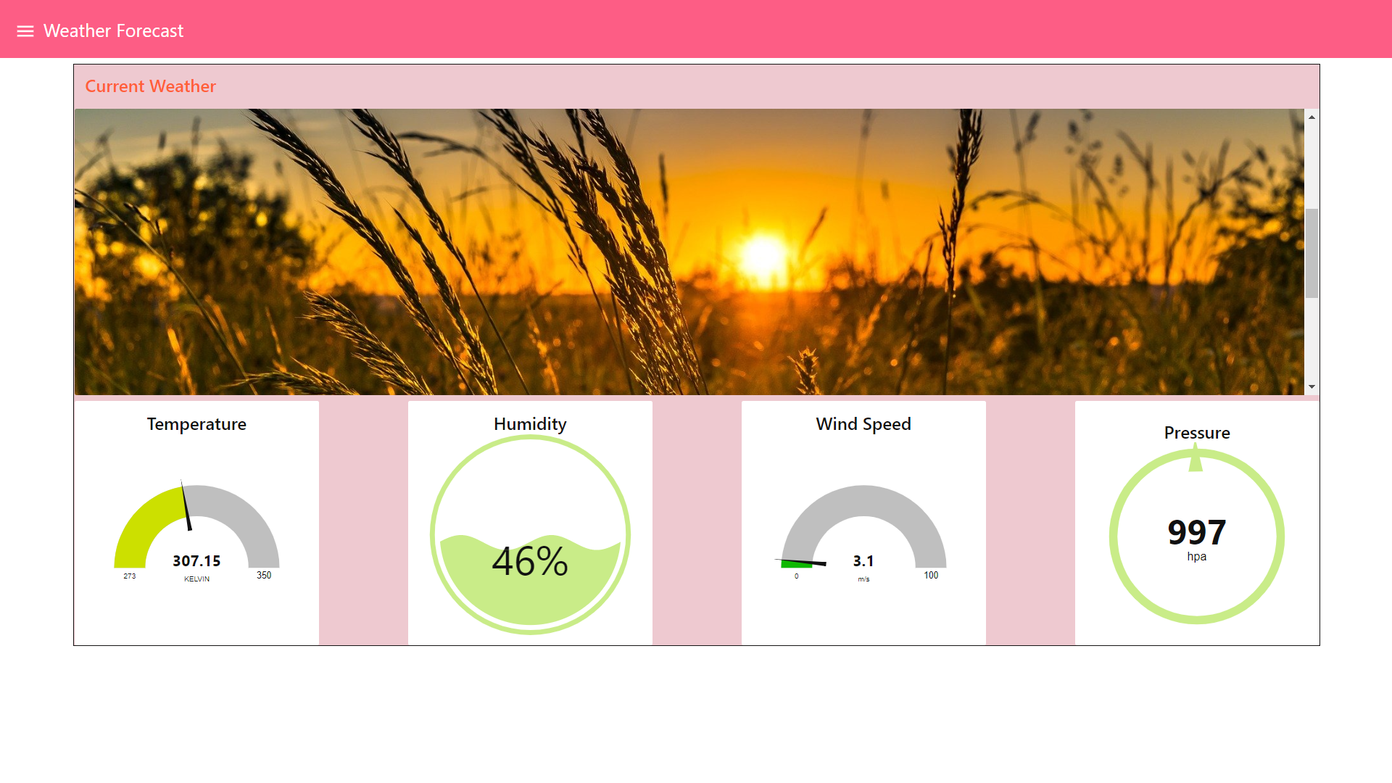
User Interface

Slide 8
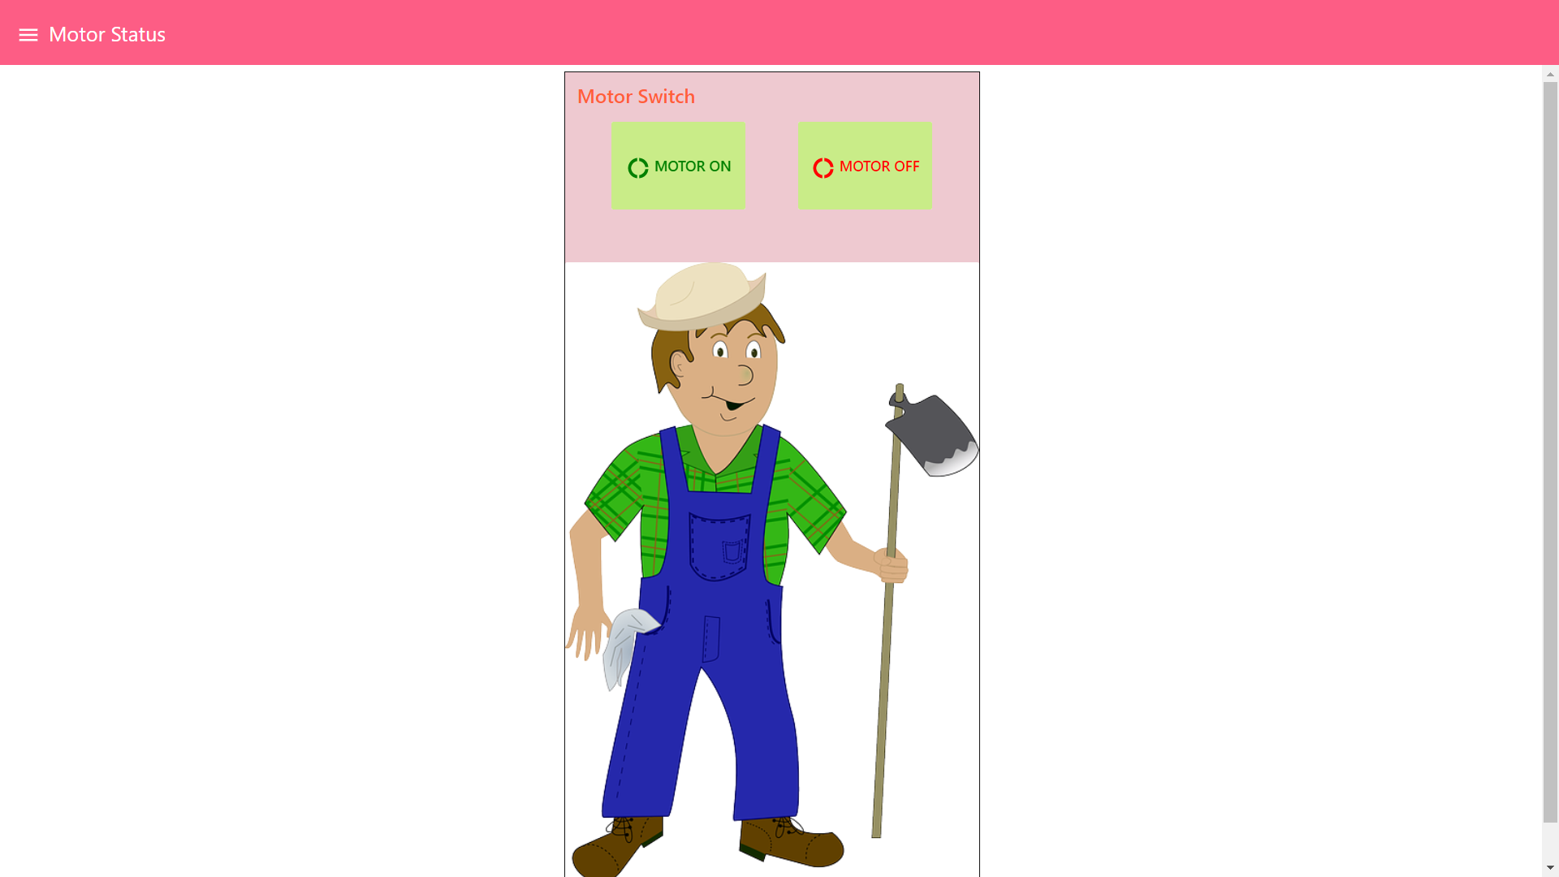
User Interface

